Slide 1
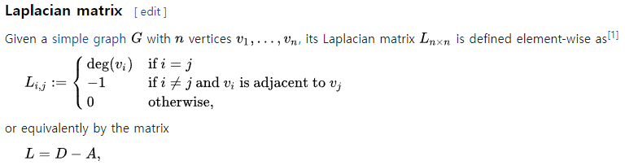
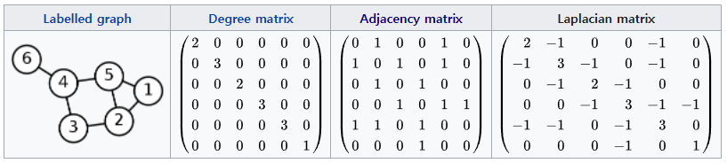
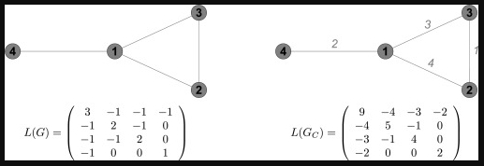
The Laplacian in RL: Learning Representations with Efficient Approximations
■ Abstract
The smallest eigenvectors(…?? Vector 인데 어떻게 제일 작아? 아마도 제일 작은 value의 vector 인 듯) of the graph Laplacian are well-known to provide a succinct(간결한) representation of the geometry of a weighted graph
- Simple graph 뿐만 아니라 다른 graph에 대해서도 정의할 수 있음
◆ The smallest eigenvalue는 0이고, 그 다음으로 작은 eigenvalue는 graph의 connectivity와 연관이 있음 (작으면 nearly disconnected)
- Weighted graph도 비슷하게 정의

Slide 2
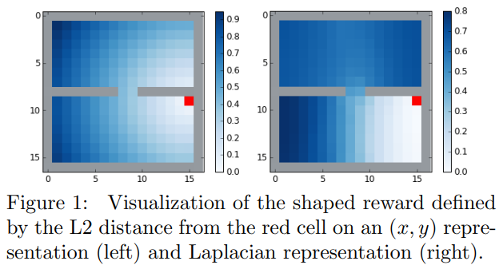
■ Abstract
The smallest eigenvector 를 찾을 때 2가지 문제점 1. Computationally expensive w.r.t a large matrix 2. simple, finite, tabular state 가 아니면 사용할 수 없음
We present a fully general and scalable method for approximation the eigenvectors of the Laplacian in a model-free RL context
Systematically evaluate our approach
Empirically show that it generalizes beyond the tabular, finite-state setting
1. Introduction
The performance of machine learning methods generally depends on the choice of data representation
Although there are many suitable such representations, in this paper, we focus on a specific approach based on the graph Laplacian, which is notable(주목할 만한) for this and several other desirable properties.

Slide 3
1. Introduction
In an RL setting, the vertices of the graph are given by the states of the environment.
For a specific behavior policy, edges between states are weighted by the probability of transitioning from one state to the other (and vice-versa).
Several previous works have proposed that approximating the eigenvectors of the graph Laplacian can be useful in RL.
Mahadevan (2005) shows that using the eigenvectors as basis functions can accelerate learning with policy iteration.
Machado et al. (2017a,b) show that the eigenvectors can be used to construct options with exploratory behavior.
The Laplacian eigenvectors are also a natural solution to the aforementioned reward-shaping problem
uniformly random behavior policy, the Laplacian state representations will induce an L2 distance as shown in Figure 1(right).
Eigendecomposition may be expansive and furthermore precludes(배제하다) the applicability of the method to stochastic or online settings, which are common in RL…?
Perhaps more crucially, the justification for many of these methods is made in the tabular setting…?

Slide 4
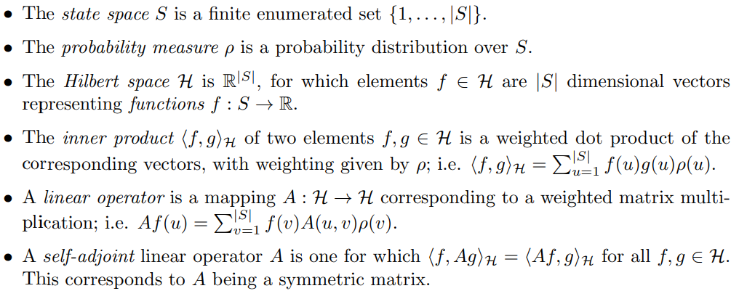
2. Background
We present the eigendecomposition framework in terms of general Hilbert spaces.
Definitions
← $v$는 standard basis의 vector라고 생각해야 할 듯, $u$도 마찬가지

Slide 5

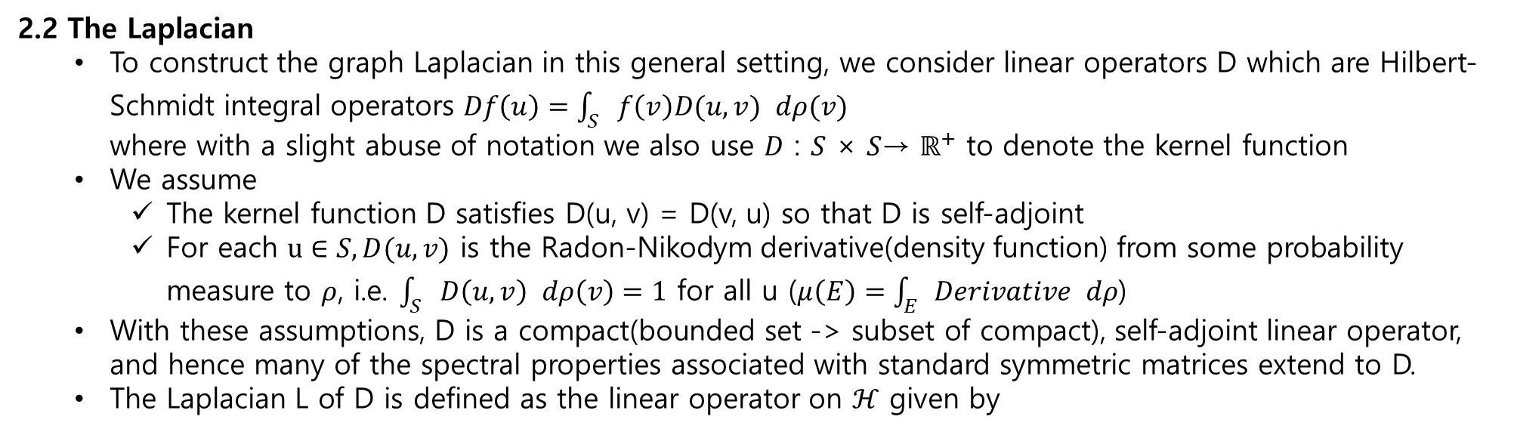
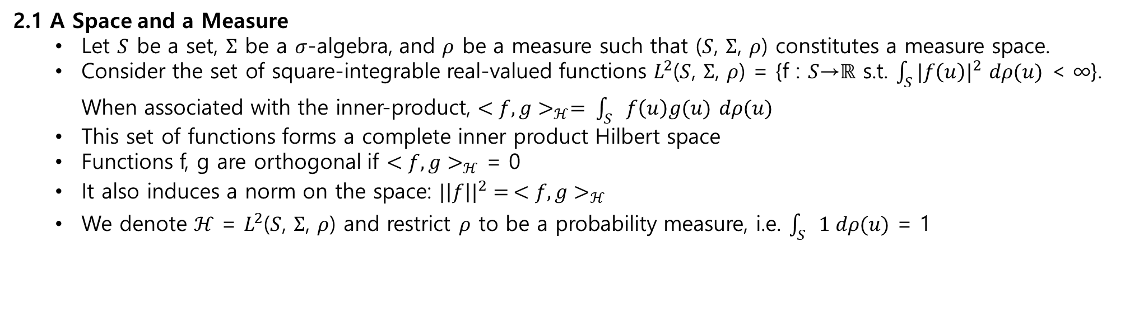
2.1 A Space and a Measure
Let $S$ be a set, $Σ$ be a $σ$-algebra, and $ρ$ be a measure such that ($S$, $Σ$, $ρ$) constitutes a measure space.
Consider the set of square-integrable real-valued functions $L^{2}$($S$, $Σ$, $ρ$) = {f : $S$→$ℝ$ s.t. $\int_{S}{{|f\left(u\right)|}^{2}}$ $dρ(u)$ < ∞}. When associated with the inner-product, ${<f, g>}_{ℋ}= \int_{S}{f\left(u\right)g(u)}$ $dρ(u)$
This set of functions forms a complete inner product Hilbert space
Functions f, g are orthogonal if ${<f, g>}_{ℋ}$ = 0
It also induces a norm on the space: ${|\left|f\right||}^{2}{= <f, g>_{ℋ}}^{}$
We denote $ℋ$ = $L^{2}$($S$, $Σ$, $ρ$) and restrict $ρ$ to be a probability measure, i.e. $\int_{S}{1 dρ(u)}$ = 1
2.2 The Laplacian
To construct the graph Laplacian in this general setting, we consider linear operators D which are Hilbert-Schmidt integral operators $Df\left(u\right)=\int_{S}{f\left(v\right)D(u,v)} dρ(v)$ where with a slight abuse of notation we also use $D$ : $S$ × $S$→ $ℝ^{+}$ to denote the kernel function
We assume
The kernel function D satisfies D(u, v) = D(v, u) so that D is self-adjoint
For each $u∈S, D(u, v)$ is the Radon-Nikodym derivative(density function) from some probability measure to $ρ$, i.e. $\int_{S}{D\left(u,v\right)} dρ\left(v\right)=1$ for all u ($μ\left(E\right)=\int_{E}{Derivative} dρ$)
With these assumptions, D is a compact(bounded set -> subset of compact), self-adjoint linear operator, and hence many of the spectral properties associated with standard symmetric matrices extend to D.
The Laplacian L of D is defined as the linear operator on $ℋ$ given by

Slide 6


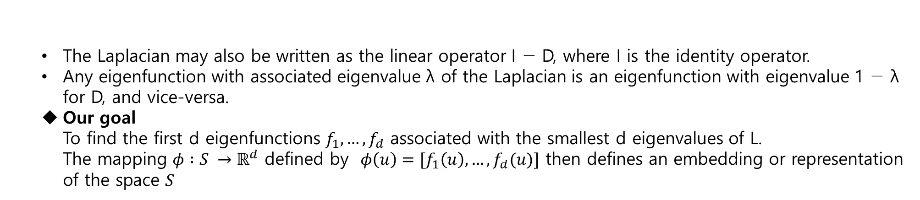
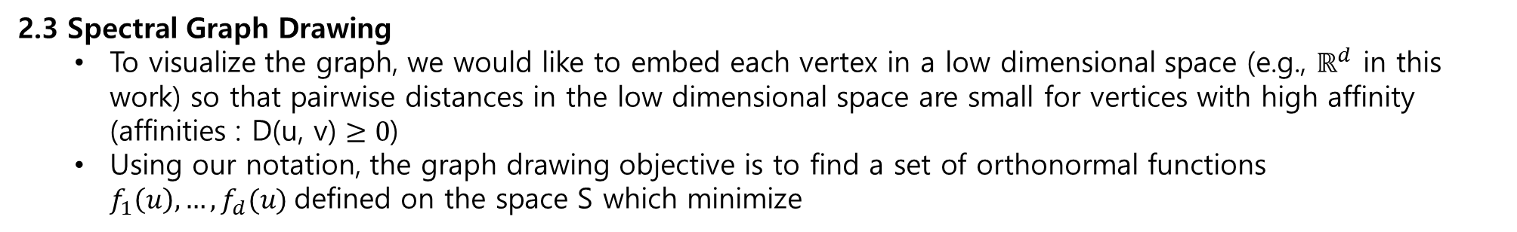
The Laplacian may also be written as the linear operator I − D, where I is the identity operator.
Any eigenfunction with associated eigenvalue λ of the Laplacian is an eigenfunction with eigenvalue 1 − λ for D, and vice-versa.
Our goal To find the first d eigenfunctions $f_{1}, …,f_{d}$ associated with the smallest d eigenvalues of L. The mapping $φ :S →ℝ^{d}$ defined by $φ\left(u\right)=[f_{1}\left(u\right), …,f_{d}(u)]$ then defines an embedding or representation of the space $S$
2.3 Spectral Graph Drawing
To visualize the graph, we would like to embed each vertex in a low dimensional space (e.g., $ℝ^{d}$ in this work) so that pairwise distances in the low dimensional space are small for vertices with high affinity (affinities : D(u, v) $≥0$)
Using our notation, the graph drawing objective is to find a set of orthonormal functions $f_{1}\left(u\right), …,f_{d}(u)$defined on the space S which minimize
The minimum value of G is the sum of the d smallest eigenvalues of L Accordingly, the minimum is achieved when $f_{1}\left(u\right), …,f_{d}(u)(여기 f들은 eigenfunction를 나타내진 않음)$span the same subspace as the corresponding d eigenfunctions

Slide 7

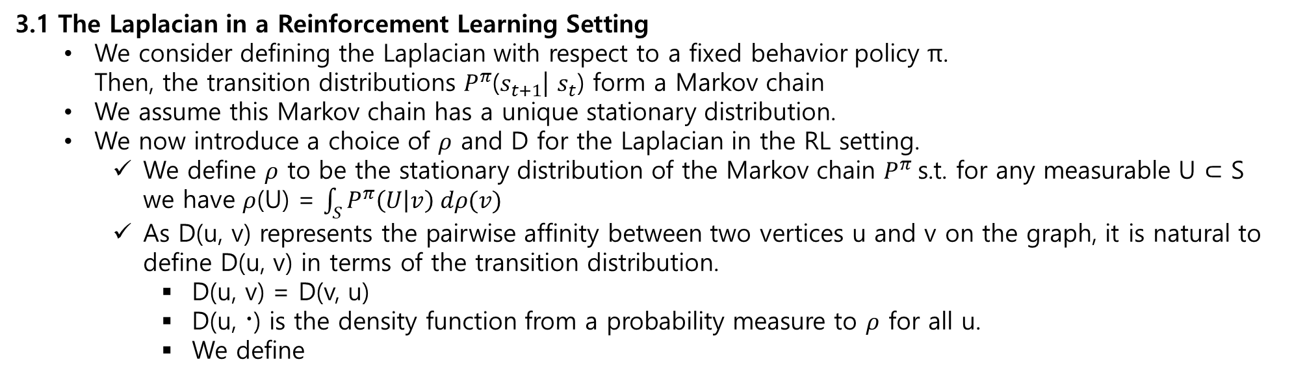
3 Representation Learning with the Laplacian
We specify the meaning of the Laplacian in the RL setting.
We elaborate on how to approx. the eigenfunctions of The Laplacian by optimizing the graph drawing objective via stochastic gradient descent on sampled states and pairs of states.
3.1 The Laplacian in a Reinforcement Learning Setting
We consider defining the Laplacian with respect to a fixed behavior policy π. Then, the transition distributions $P^{π}$($s_{t+1}$| $s_{t}$) form a Markov chain
We assume this Markov chain has a unique stationary distribution.
We now introduce a choice of $ρ$ and D for the Laplacian in the RL setting.
We define $ρ$ to be the stationary distribution of the Markov chain $P^{π}$s.t. for any measurable U $⊂$ S we have $ρ$(U) = $\int_{S}{P^{π}\left(U | v\right) dρ(v)}$
As D(u, v) represents the pairwise affinity between two vertices u and v on the graph, it is natural to define D(u, v) in terms of the transition distribution.
D(u, v) = D(v, u)
D(u, 〮) is the density function from a probability measure to $ρ$ for all u.
We define
In other words, the affinity between states u and v is the average of the two-way transition probabilities: If S is finite then the first term is $P^{π}$($s_{t+1}=v$| $s_{t}= u$) / $ρ(v)$ and the second term is $P^{π}$($s_{t+1}=u$ | $s_{t}=v$) / $ρ(u)$ .

Slide 8



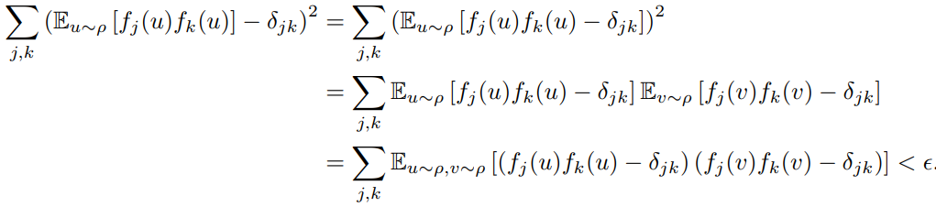
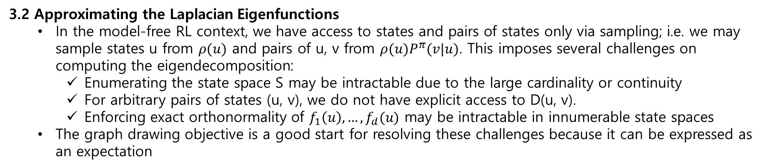
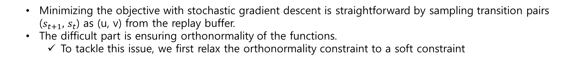
3.2 Approximating the Laplacian Eigenfunctions
In the model-free RL context, we have access to states and pairs of states only via sampling; i.e. we may sample states u from $ρ(u)$ and pairs of u, v from $ρ(u)P^{π}(v|u)$. This imposes several challenges on computing the eigendecomposition:
Enumerating the state space S may be intractable due to the large cardinality or continuity
For arbitrary pairs of states (u, v), we do not have explicit access to D(u, v).
Enforcing exact orthonormality of $f_{1}\left(u\right), …,f_{d}(u)$ may be intractable in innumerable state spaces
The graph drawing objective is a good start for resolving these challenges because it can be expressed as an expectation
Minimizing the objective with stochastic gradient descent is straightforward by sampling transition pairs ($s_{t+1},$ $s_{t}$) as (u, v) from the replay buffer.
The difficult part is ensuring orthonormality of the functions.
To tackle this issue, we first relax the orthonormality constraint to a soft constraint
Using standard properties of expectations, we rewrite the inequality as follows:

Slide 9
In practice, we transform this constraint into a penalty and solve the unconstrained minimization problem.
Where β is the Lagrange multiplier

